Slide 1
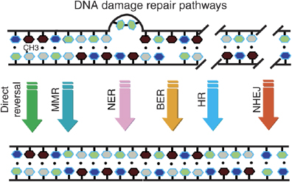
Multiple repair mechanisms exist to counteract mutations

Slide 2
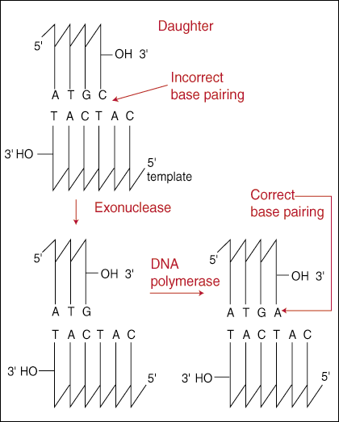
DNA polymerases have proofreading activity
DNA polymerases are able to recognize and correct errors in replication (proofreading).

Slide 3
Mismatch repair
Mismatch repair corrects errors that remain after proofreading.
The correct DNA strand is recognized based on DNA methylation of the parental strand at the GATC sequence.
The methylation of the A in GATC is carried out by dam methylase.
In E. coli, mutS recognizes the initial mismatch, and mutH and mutL make the nick.

Slide 4
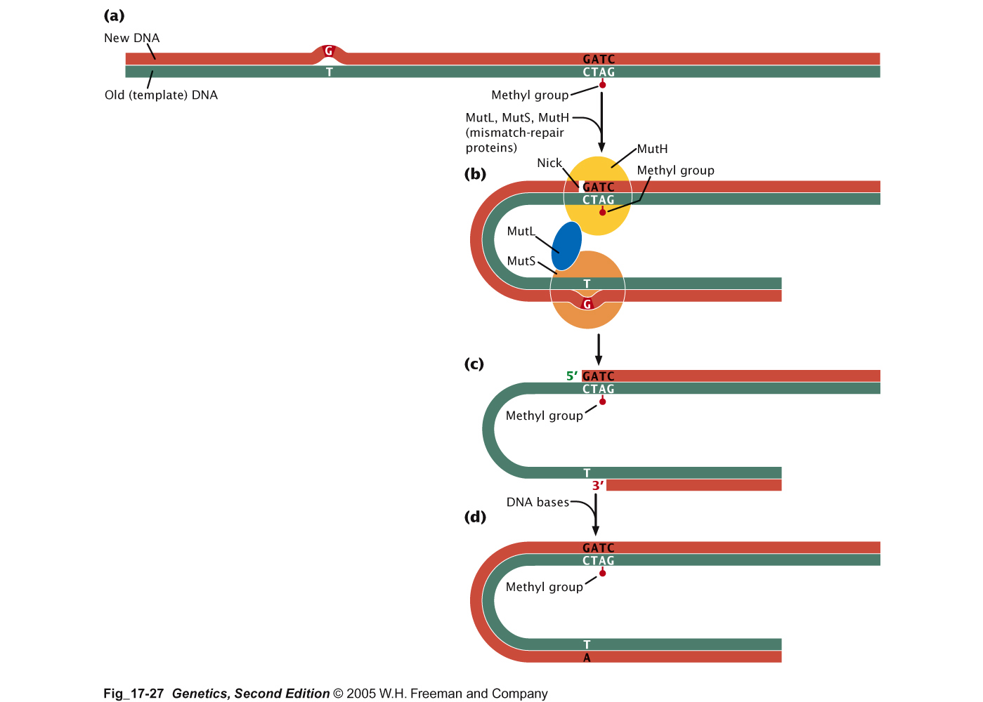
Mismatch repair

Slide 5
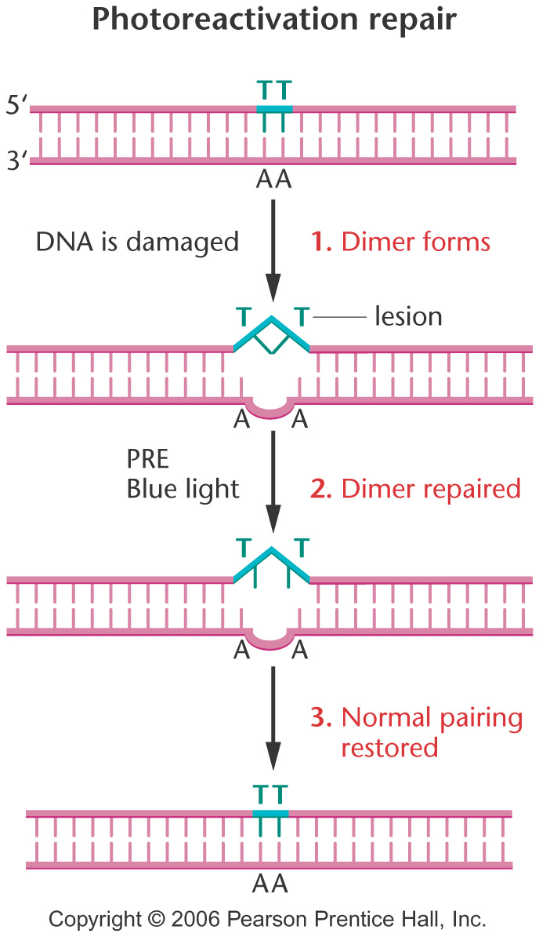
Photoreactivation repair removes thymine dimers caused by UV light. The process depends on the activity of a protein called the photoreactivation enzyme (PRE).

Slide 6
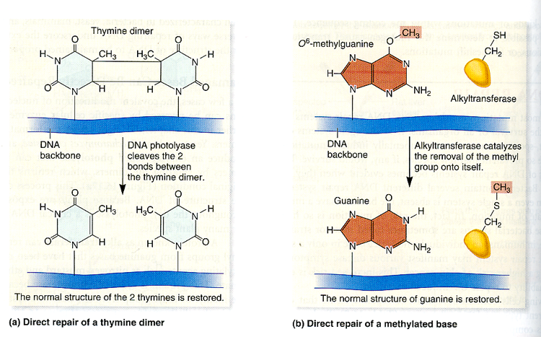
Direct repair
Direct repairs do not replace altered nucleotides.

Slide 7
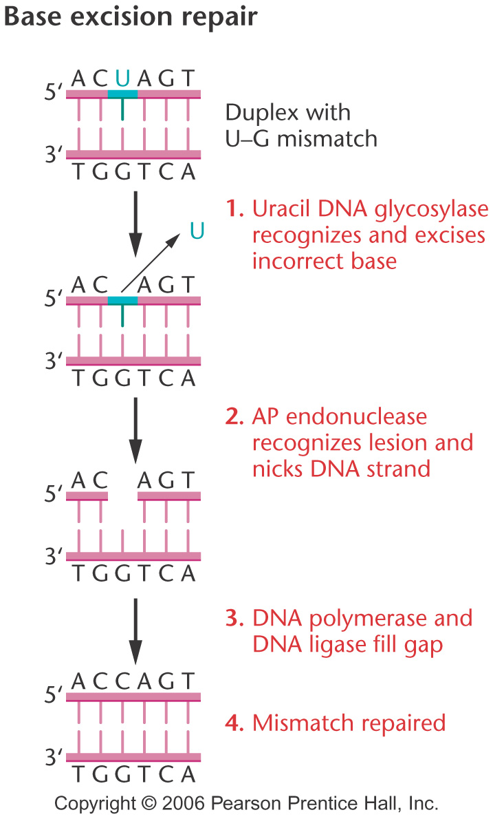
Base excision repair (BER)
Major pathway for repair of modified bases, uracil misincorporation, oxidative damage
Various DNA glycosylases recognize lesion and remove base at glycosidic bond, thereby producing an “abasic” or AP (apurinic/ apyrimidinic) site by base “flipping out”
One of several AP endonucleases incises phosphodiesterase backbone adjacent to AP site
patch refilled by DNA synthesis and ligation

Slide 8
Deamination
NH₂
O
4
CH₃
3
HN
N
5
O
O
2
1
6
O
N
O
N
5’
H₂C
H₂C
O
O
glycosidic bond
4’
1’
3’
2’
O
O
deoxycytosine
deoxyuracil
thymine

Slide 9
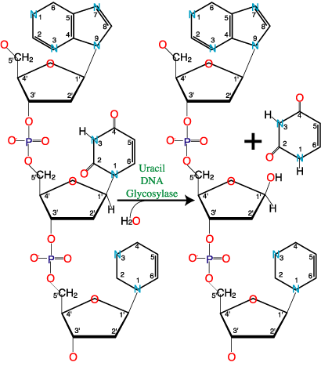

Slide 10
Types of lesions repaired by BER
Deoxyuracil: from misincorporation of dU or deamination of dC-->dU.
These lesions are not distorting and do not block DNA polymerases.
Spontaneous depurination (esp. G) yield abasic sites that are repaired by second half of BER pathway.

Slide 11
Contribution of proofreading, base excision repair and MMR to mutation avoidance
Genotype | Rif^{r} mutants per 10⁸ cells
Wild-type mut⁺ | 5-10
mutD (dnaQ) Pol III proofreading | 4000-5000
mutS MMR | 760
mutY mutM 8-oxoG BER | 8200

Slide 12
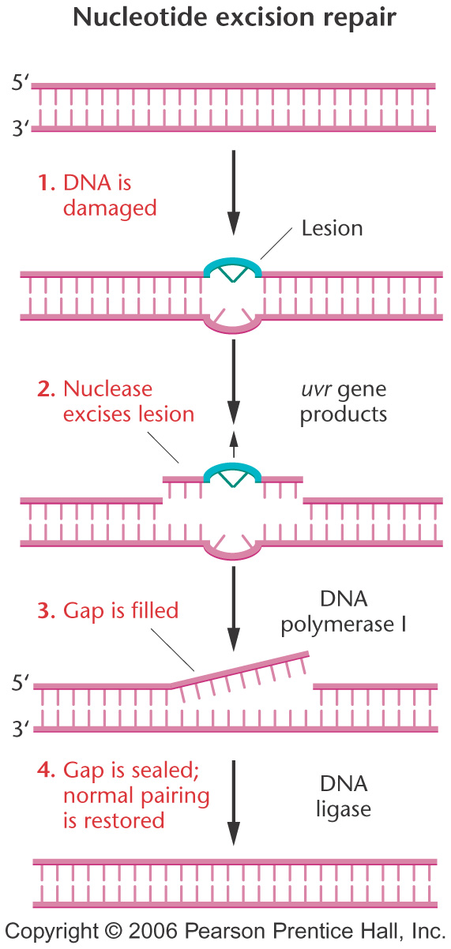
Nucleotide excision repair (NER)
Recognizes bulky lesions that block DNA replication (i. e. lesions produced by carcinogens)--example, UV pyrimidine photodimers.
Common distortion in helix.
Incision on both sides of lesion.
Short patch of DNA excised, repaired by repolymerization and ligation.
In E. coli, mediated by UvrABCD.
Many more proteins involved in eukaryotes.
Defects in NER underlie Xeroderma pigmentosum.

Slide 13
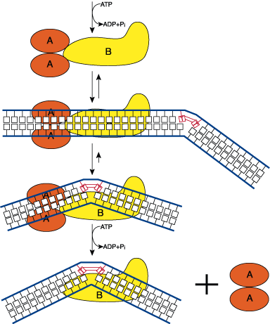
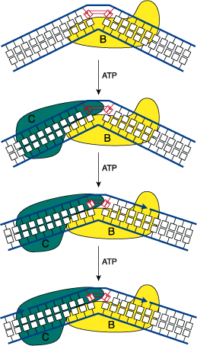
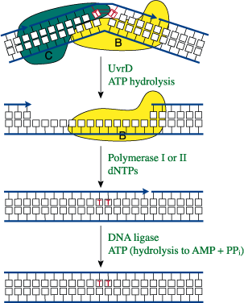
Recognition and binding
Incision
Excision and repair
UvrA acts as classical “molecular matchmaker”
Nicks delivered 3’ and 5’ to lesion by UvrBC
Short fragment released by helicase action

Slide 14
Proteins Required for Eukaryotic Nucleotide Excision Repair
S. cerevisiae protein Human protein Probable function
Rad14 XPA Binds damaged DNA after XPC or RNA pol II
Rpa1,2,3 RPAp70,p32,p14 Stabilizes open complex (with Rad14/XPA); positions nucleases
Rad4 XPC Works with hHR23B; binds damaged DNA;
recruits other NER proteins
Rad23 hHR23B Cooperates with XPC (see above); contains ubiquitin domain; interacts with proteasome and XPC
Ssl2 (Rad25) XPB 3' to 5' helicase
Tfb1 p62 ?
Tfb2 p52 ?
Ssl1 p44 DNA binding?
Tfb4 p34 DNA binding?
Rad3 XPD 5' to 3' helicase
Tfb3/Rig2 MAT1 CDK assembly factor
Kin28 Cdk7 CDK; C-terminal domain kinase; CAK
Ccl1 CycH Cyclin
Rad2 XPG Endonuclease (3' incision); stabilizes full open complex
Rad1 XPF Part of endonuclease (5' incision)
Rad10 ERCC1 Part of endonuclease (5' incision)

Slide 15
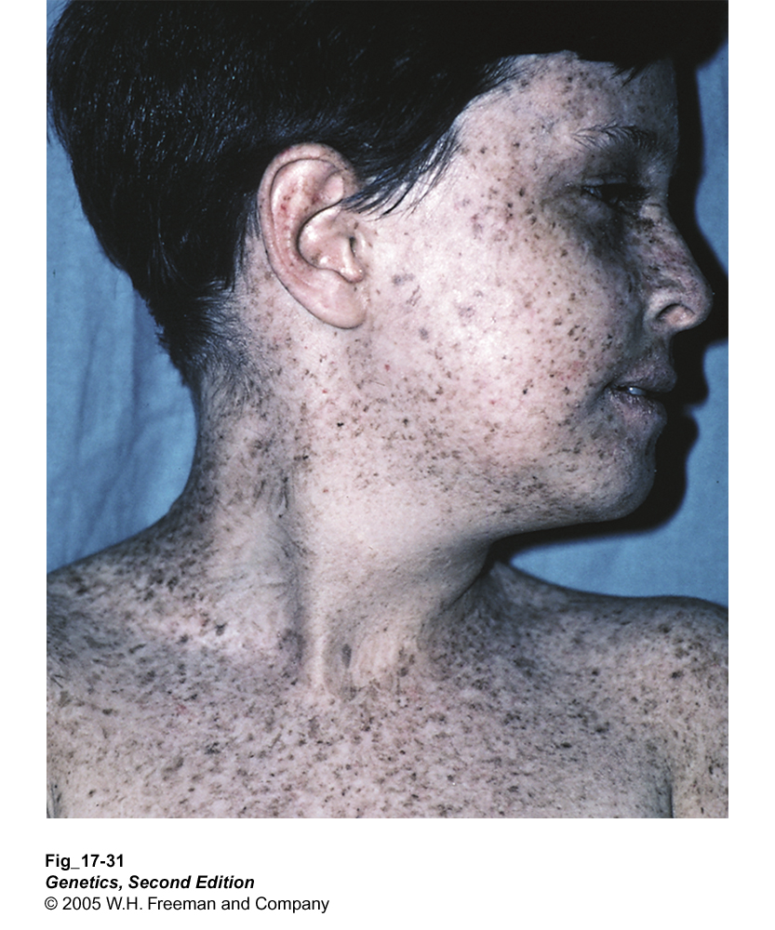
Xeroderma pigmentosum
Autosomal recessive mutations in several complementation groups
Extreme sensitivity to sunlight
Predisposition to skin cancer (mean age of skin cancer = 8 yrs vs. 60 for normal population)

Slide 16
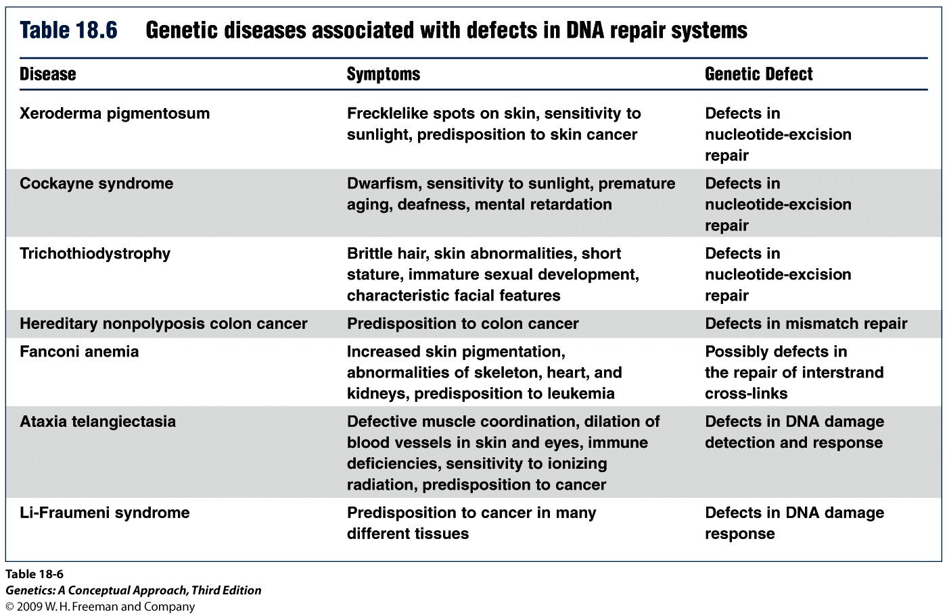

Slide 17
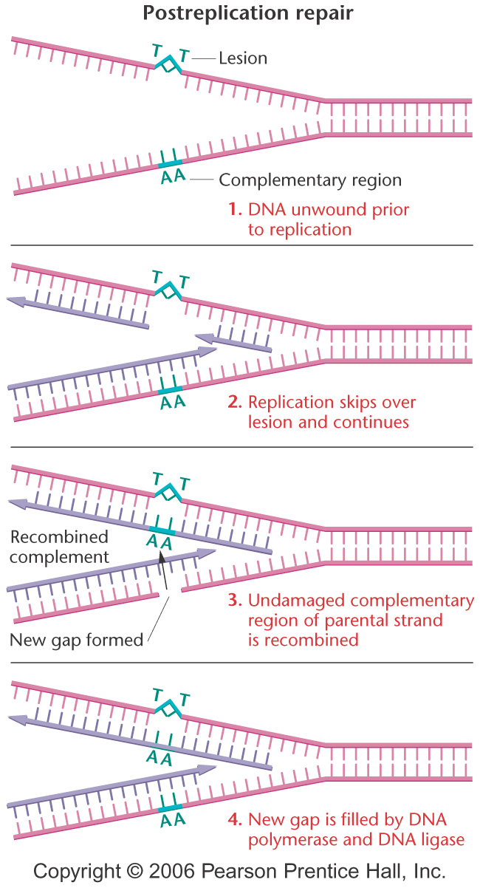
Post-replication repair occurs when DNA replication skips over a lesion (for example, T-dimer) and requires homologous recombination mediated by the RecA protein. This is also known as homologous recombination repair.

Slide 18
SOS repair
The SOS repair system involves at least 25 genes, including recA, lexA and uvr.
It allows insertion of bases into the new DNA strand in the absence of bases on the template strand. As a result, DNA synthesis becomes error-prone when SOS is activated.
Although SOS repair is itself mutagenic, it may allow the cell to survive DNA damage that might otherwise kill it.

Slide 19
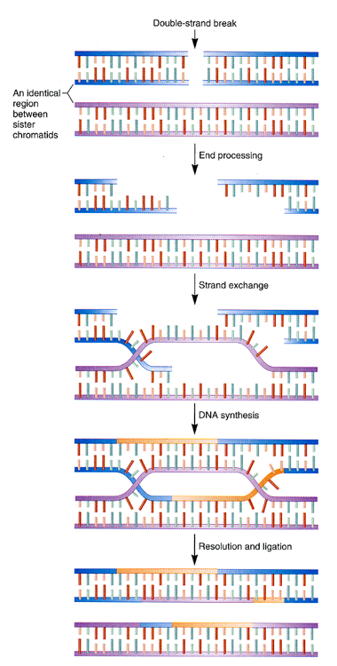
Double-strand break
1. Homologous recombination repair
Homologous recombinational repair fixes a double-strand DNA break by digesting back the 5' ends of the broken helix to leave overhanging 3' ends.
The 3’ overhangs then interact with a region of an undamaged sister chromatid to allow DNA polymerase to copy the undamaged DNA sequence into the damaged strand.

Slide 20
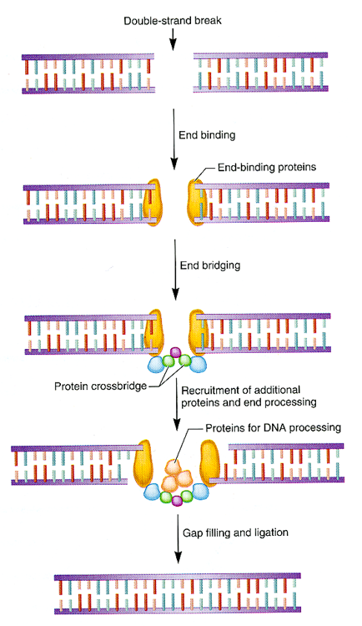
Double-strand break
2. End joining repair
End joining repairs double-stranded breaks but does not require a homologous region of DNA during repair.

